Slide 1
Sub-Unit 32: Paying Employees
Pages 674-695
Notes:
Next year, have someone from the “Employment Standards Branch” of our provincial department of labour come speak to the class
To intro the unit, have students who work part-time share:
Place of work
Hours of work (per pay period)
Amount of pay/hour
Method of payment
Deductions on their paychecks
Ask: Do you know any of the laws governing hours, payment, method of payment and/or deductions?

Slide 2
Sub-Unit Topics
By the end of this unit, you will know how to:
Identify the 3 compulsory deductions, and outline the benefits of each deduction
Identify 5 common voluntary deductions, and outline the benefits of each deduction
Explain the purpose served by a Social Insurance Number (SIN)
Calculate a net claim code for income tax deduction purposes
Calculate net earnings
Identify 5 pay periods used by businesses
Identify 6 payment methods used by employers

Slide 3
Lesson 1: Employment Laws
Independent Reading: Textbook
Section 1: 674-676 (up to “Deductions”)
Definitions: Notebook
Payroll, Employment Laws, Provincial vs. Federal, Statement of Earnings and Deductions
Check Your Understanding – Text 692
Questions 2-3
Internet Research Questions – Provincial Employment Laws [see class site]
Do the Employment Laws cover all employees in Manitoba? Explain.
Which department of the provincial government administers these laws?
What is the current minimum wage, maximum hours of work per pay period, set statutory holidays, holiday pay, and overtime pay set by the province of Manitoba?
Notes:
Provincial - Manitoba Employment Standards: https://www.gov.mb.ca/labour/standards/doc,quick_guide,factsheet.html
Federal - Canada Revenue Agency:
http://www.cra-arc.gc.ca/payroll/

Slide 4
Payroll
A list of employees and money to be paid to them for salaries/wages

Slide 5
Employment Laws
Laws that govern payroll procedures and payment amount, frequency and deductions

Slide 6
Provincial Set and followed by Province | Federal Set and followed by Canada
Minimum Wage | Income Tax Act
Hours of Work | Employment Insurance Act
Statutory Holidays | Canada Pension Act
Overtime
Age Requirements
Working Conditions

Slide 7
Lesson 2: Deductions
Independent Reading: Textbook
Section 2: 676-685 (up to page’s end)
Definitions: Notebook
Deductions, Compulsory Deductions, Voluntary Deductions, Social Insurance Number
Deduction Outlines:
For the 3 compulsory deductions, and the 5 voluntary ones, outline the following:
What the deduction is
Who the deduction affects (consider both the employee and the employer)
How much (approx.) the deduction is worth
The benefits the deduction provides
Check Your Understanding – Text 692
Questions 4-8 (*Note: you may need to do a little research)
Apply Your Knowledge – Text 695, Wrk 470 (use Ex. 12 template, not Ex. 13)
Exercise 13 (look up this year’s Manitoba and Federal TD1 forms online) [see class site]
Notes:
Introduce this portion of the unit by asking: What is Income Tax and why do we have to pay it?
Manitoba TD1 Form (2017):
http://www.cra-arc.gc.ca/E/pbg/tf/td1mb/td1mb-17e.pdf
Federal TD1 Form (2017):
http://www.cra-arc.gc.ca/E/pbg/tf/td1/td1-17e.pdf
Federal and Provincial Claim Codes (2015):
http://www.cra-arc.gc.ca/tx/bsnss/tpcs/pyrll/t4008/2015/t4008-mb-gnrlnf-eng.html#_Toc334772403
Federal and Provincial Tax Deduction Tables (2017):
http://www.cra-arc.gc.ca/tx/bsnss/tpcs/pyrll/t4008/2017/t4008-mb-27pp-17eng.pdf

Slide 8
Deductions
Amount of money subtracted from an employee’s gross earnings

Slide 9
Compulsory Employers are required, by law, to deduct these items | Voluntary Employers only make these deductions upon employee’s request
Personal Income Tax | Group Life Insurance
Employment Insurance | Credit Unions
Canada Pension Plan | Health Insurance
 | Extended Health Insurance
 | Registered Pension Plan
 | Union Dues

Slide 10
CPP & EI
Accountants calculate these by looking at the current Payroll Deduction Tables
CPP: ~4.95% of salary is deducted on each paycheck
EI: deduction % depends on the amount of employee’s salary

Slide 11
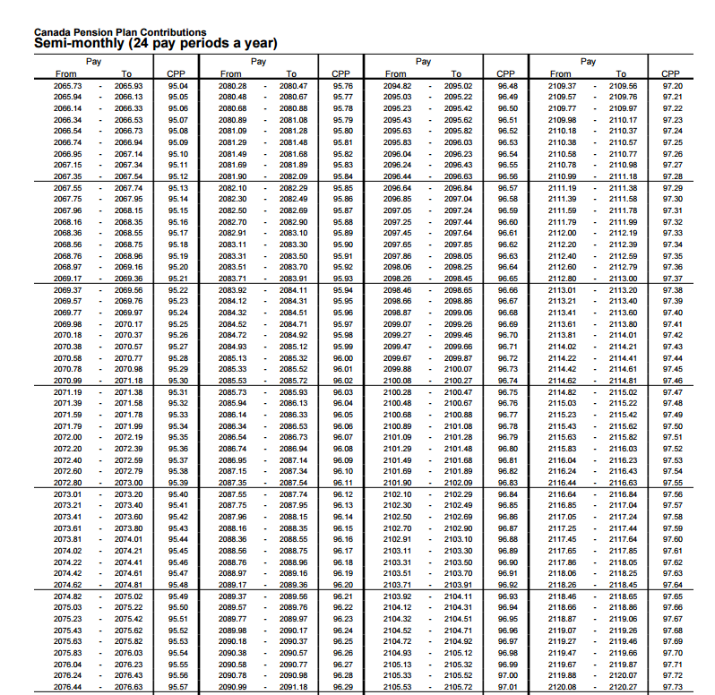
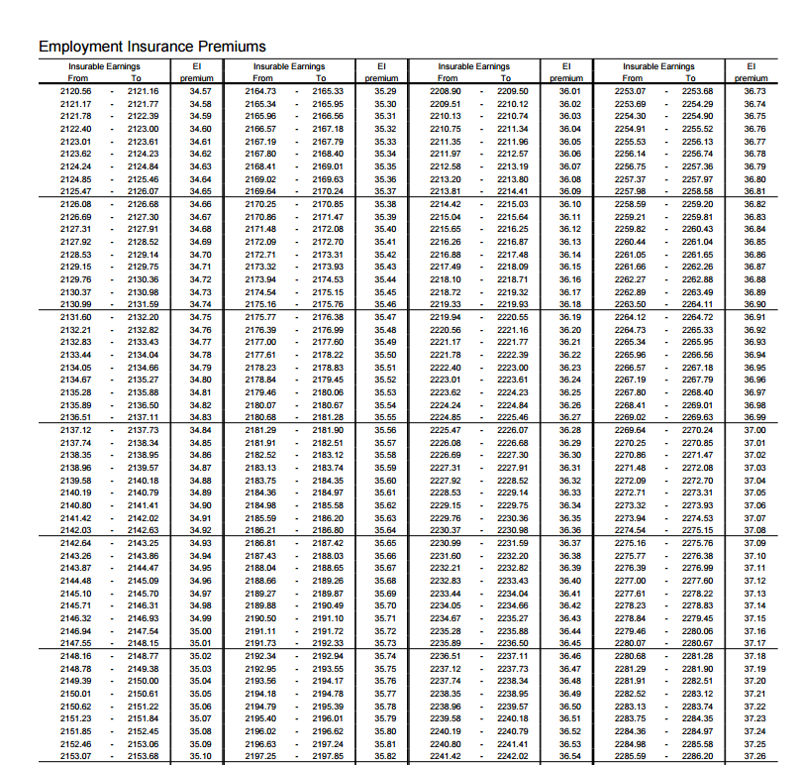

Slide 12
Income Tax
Accountants calculate this by following a 3-Step Process*
Have employees complete a TD1 form
Use the Total Claim Amount from TD1 form to determine Net Claim Code
Look up the Net Claim Code on the Payroll Deduction Table to determine Income Tax deduction
Both Provincial AND Federal Income Tax is deducted from each paycheck. The amount is determined as follows:
Figure out salary
Figure out Federal tax bracket %
(Salary) x (%) = Annual Income Tax
(Annual Income Tax)/(# Pay Periods)
Repeat for Provincial Income Tax
Notes:
*This process is not 100% accurate, because with most jobs it is impossible to tell, in advance, how much money an employee will make over the course of a year, thus it is impossible to calculate which tax bracket an employee will fall into (and it is tax brackets that determine which percentage of income is ultimately deducted to pay for income tax)
*Since this process is not 100% accurate, oftentimes, employees will either be issued a refund (if they paid too much income tax over the course of the year, i.e. made less money than expected) or be charged additional income tax (if they paid too little income tax over the course of the year, i.e. made more money than expected)

Slide 13
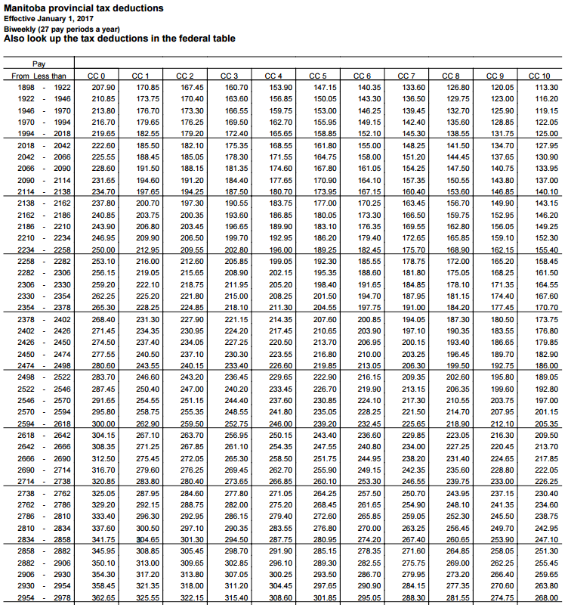
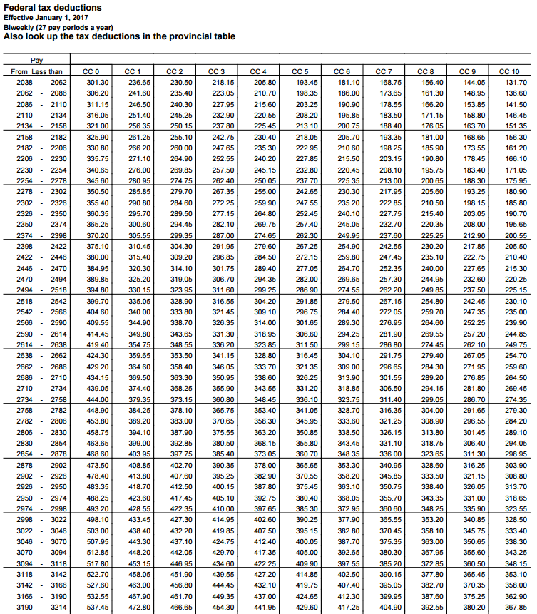

Slide 14
2017 Tax Brackets – FYI ☺
Provincial Go towards Provincial Funding | Federal Go towards Canada-wide funding
$9 272.00* - $31 465.00 10.8% | $11 636.00* - $45 915.00 15%
$31 466.00 - $68 005.00 12.75% | $45 916.00 - $91831.00 20.5%
$68 006.00+ 17.4% | $91 832.00 - $142 353.00 26%
 | $142 354.00 - $202 800.00 29%
 | $202 800.00+ 33%
*Basic Personal Amount

Slide 15
Ms. Hammond’s Current Salary = $58 000/Year
SO
Federal Income Tax: 20.5%
Provincial Income Tax: 12.75%
SO
20.5 + 12.75 = 33.25
58 000 x 33.25% (.3325) = $19 285/Year
SO
$58 000 - $19 285 = $38 715 after IT deduction

Slide 16
TD1 Forms
Inform employer of tax credits applicable to each employee; this helps the accountant determine the correct amount of income tax to deduct/paycheck
Are not the same as T1 forms
(which are the forms you fill out during Income Tax time, which is when you check whether or not the correct amount of income tax has been deducted throughout the year, resulting in either an additional payment or a refund)
Notes:
TD1 forms must be completed by each employee at the time of employment (for each new job)
TD1 forms determine the amount of Tax Credits that each employee qualifies for; tax credits reduce the amount of income tax the employee has to pay to the provincial/federal government
There is both a Federal and a Provincial TD1 form

Slide 17
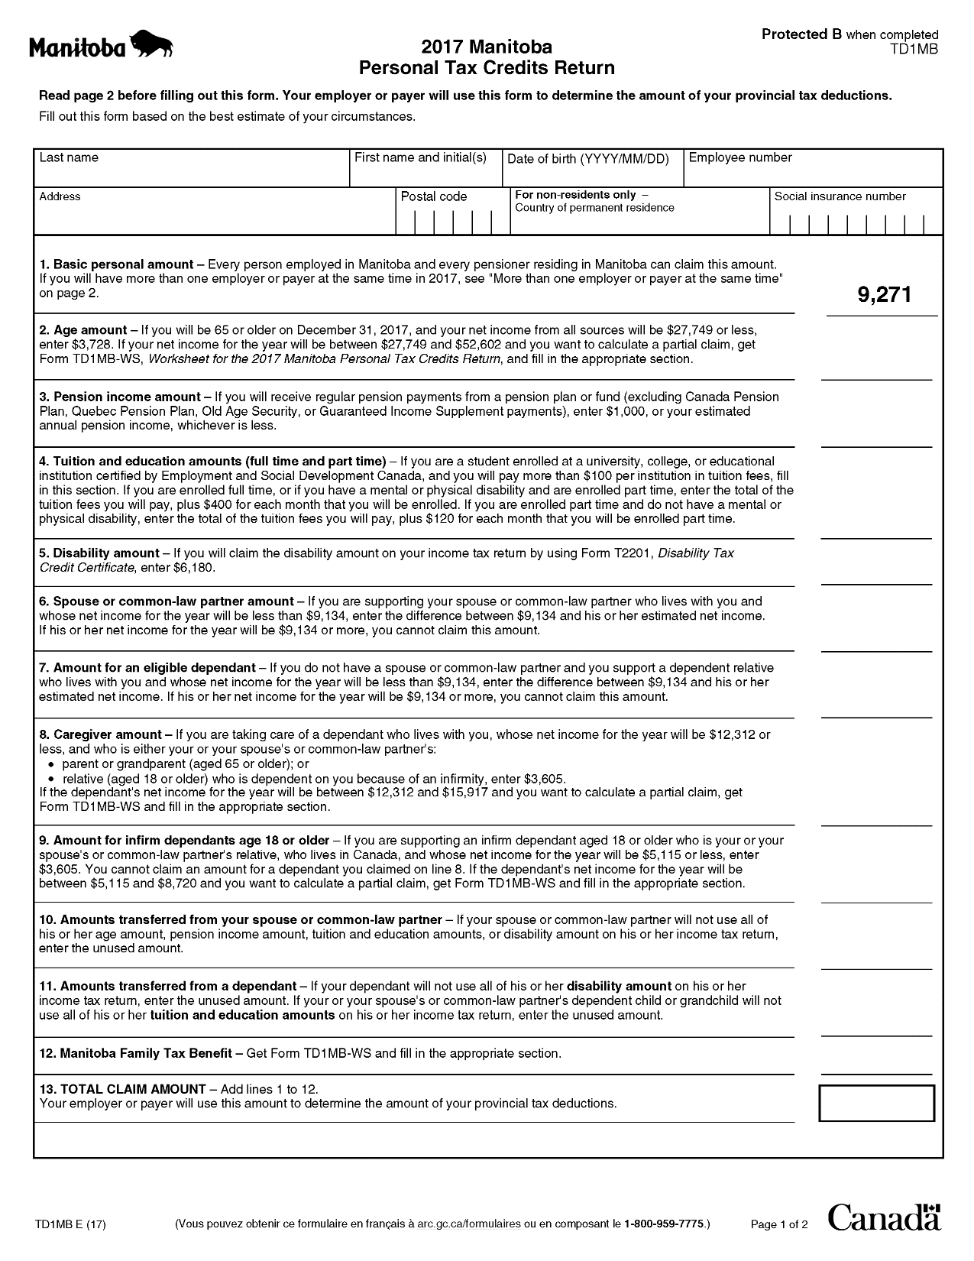
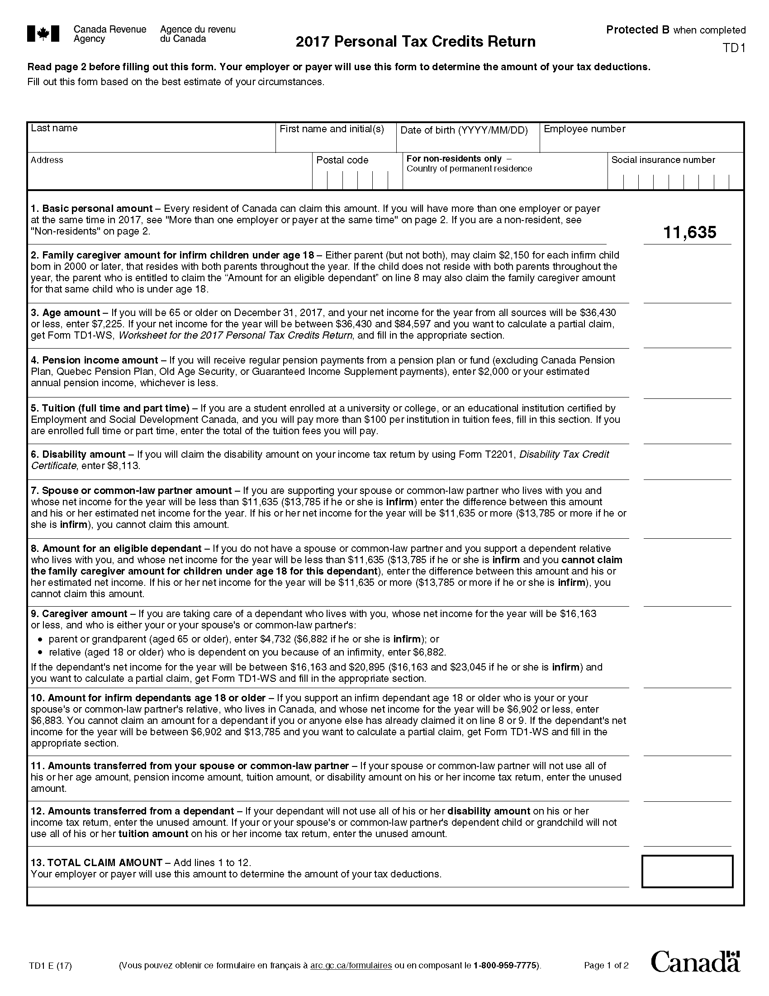

Slide 18
Lesson 3: Calculating Net Earnings
Independent Reading: Textbook
Section 3: 686-691 (up to unit’s end)
Definitions: Notebook
Gross Earnings, Net Earnings, Taxable Earnings, Payroll Deduction Tables, Salary, Hourly Rate, Commission, Piece Rate, Overtime, Unions (you may have to research this one)
Check Your Understanding – Text 692
Questions 9-12
Apply Your Knowledge – Text 693-695, Wrk 465-469
Exercises 1-10 (look up this year’s Payroll Deductions Tables – for EI/CPP/IT – online) [see class site]
Notes:
Current Payroll Deductions Tables:
http://www.cra-arc.gc.ca/E/pub/tg/t4032on/README.html
Income Tax Codes and Tables:
Manitoba TD1 Form (2017):
http://www.cra-arc.gc.ca/E/pbg/tf/td1mb/td1mb-17e.pdf
Federal TD1 Form (2017):
http://www.cra-arc.gc.ca/E/pbg/tf/td1/td1-17e.pdf
Federal and Provincial Claim Codes (2015):
http://www.cra-arc.gc.ca/tx/bsnss/tpcs/pyrll/t4008/2015/t4008-mb-gnrlnf-eng.html#_Toc334772403

Slide 19
Mini-Assignment #1:
Paying Employees [Exercise 11, page 695]
Complete Mini-Assignment 1: Paying Employees (use the print version, rather than your textbook – it’s just easier)
Use the printed assignment provided to you by Ms. Hammond
Make sure your name is on the top of the assignment
Submit your assignment for assessment (in a neat
pile atop Ms. Hammond’s wooden desk)
Notes:
Option 1 for Mini-Assignment

Slide 20
PowerPoint 81 Chapter 14, Unit 33
The Payroll Accounting System
20
Principles of Accounting, 4th edition

