Slide 1
Framing
Definition:
Using other elements within your scene to draw attention to the main subject.
Framing brings more depth and sophistication to a picture and creates a clear focal point.
Example:
Notice how the preacher is holding the Bible in such a way that his arms and the Bible frame his face. This creates a frame that emphasizes his face.
Notes:
What is the subject? How do you know?
What is acting as the frame?

Slide 2
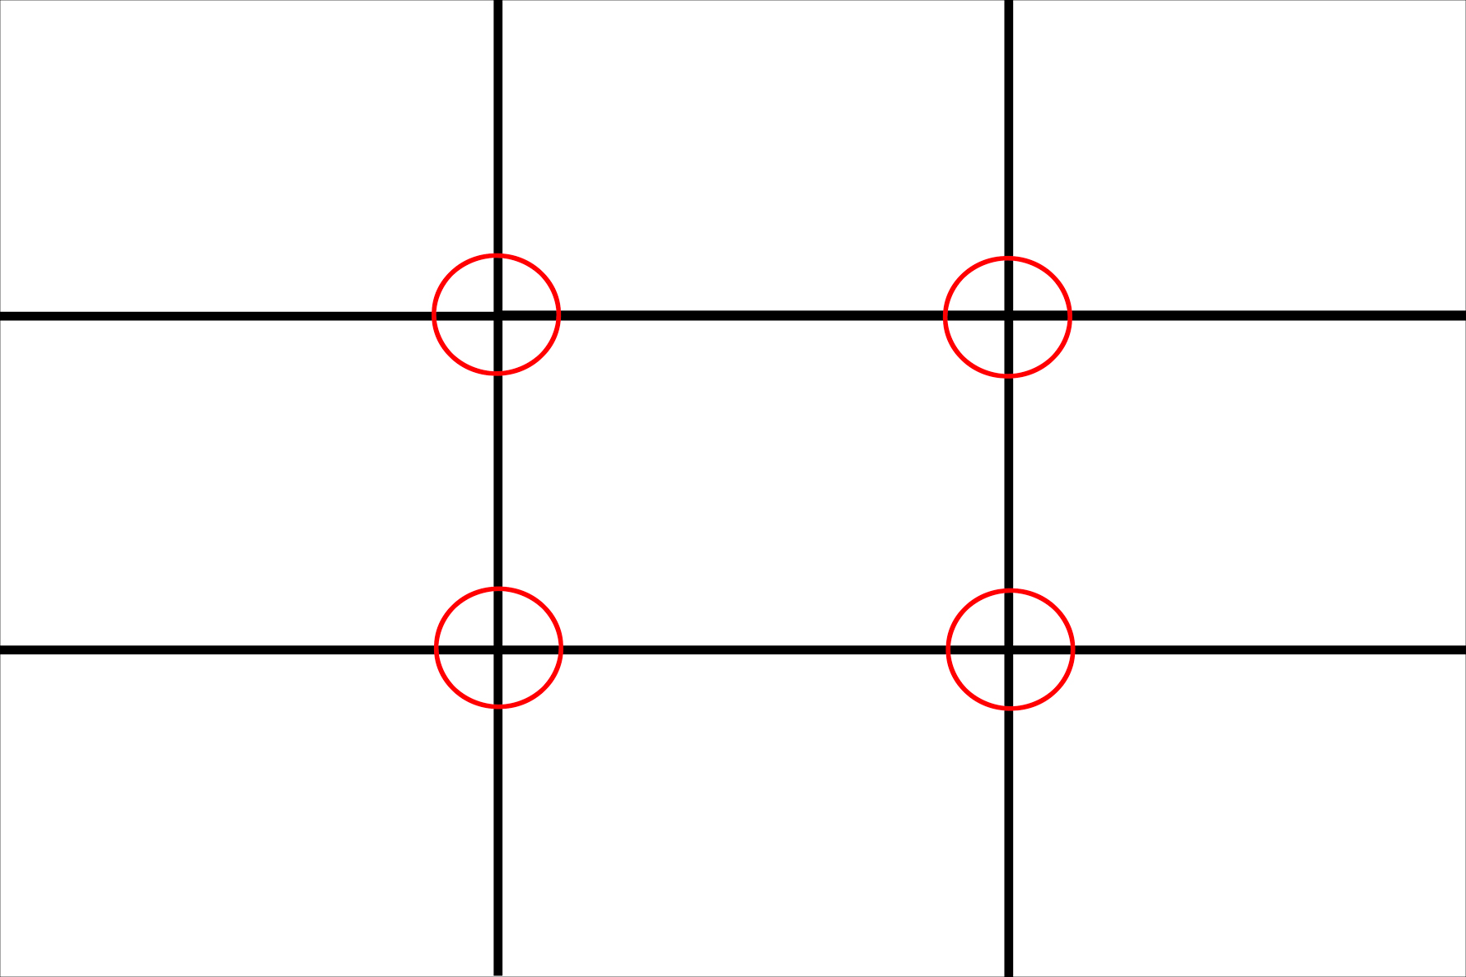
Rule of thirds
Definition:
A picture with the subject placed slightly off-center is, typically, more interesting to a viewer. The Rule of Thirds requires the photographer to break a picture down into 9 parts (2 horizontal lines & 2 vertical lines), and to align the subject with 1 of the 4 cross-sections.
Example:
Notice how, in this scene, the tower is off-center, towards the right-hand side of the scene. In terms of the “Rule of Thirds,” the subject would be located in the top-right cross-section.
Notes:
This is all done in your head, not right on the photograph.
Still symmetrical, yet more intriguing because it is unexpected
What is the subject? How do you know?
Do you agree that placing the subject off to one side makes each picture more attractive?

Slide 3
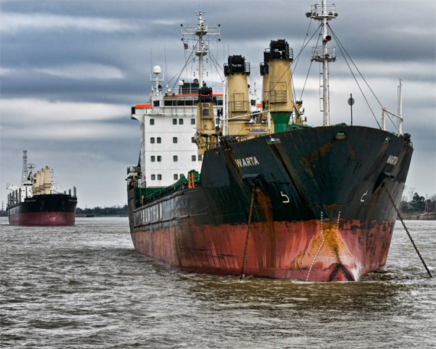
FOCAL point
Definition:
The place the viewer’s eye is drawn first – i.e the main subject, or most important part of the photograph. A clear focal point = a clear message.
Focal point can be communicated in several different ways: framing, rule of thirds, colour, focus, size, etc.
Example:
Notice how, in this scene, the size of the larger ship, compared to the size of the smaller ship is used to create a focal point.
Notes:
What is the subject? How do you know?
Which of the 5 focal point techniques discussed, so far, do you think is most effective?

Slide 4
Unusual angles
Definition:
Photographing a subject from an angle other than head-on. Using an unusual angle adds interest to your photograph, since it allows your viewer to experience your subject in a different way.
Some examples include low angles, high angles, birds-eye views, or tilts.
Example:
Notice how, in this scene, the old cross is photographed from a low angle, creating a feeling of reverence, awe, and submission in the viewer.
Notes:
What type of angle is used here?
What kind of effect does it have on the viewer?

Slide 5
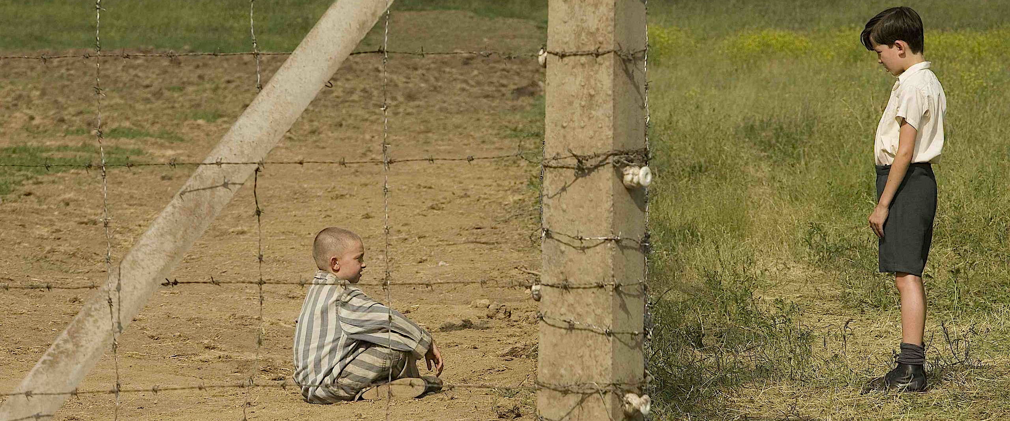
Line
Definition:
Lines are used to lead your viewer’s eye towards your focal point, create balance and symmetry, divide parts of a scene, and to grab the viewer’s attention by boldening a picture’s look.
Hard, strong lines usually communicate rigidness, sophistication, precision, etc., while soft, curved lines usually communicate calm, playfulness, freedom etc.
Example:
Notice how, in this scene, lines are used to communicate a vast amount of information about the two subjects contained in it, including their circumstances.
Notes:
What type of angle is used here?
What kind of effect does it have on the viewer?

Slide 6
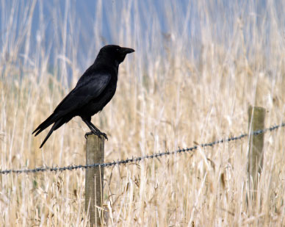
Active space
Definition:
Leaving empty, space beside your subject, creating the illusion that your subject will “move into” this space. Placing a subject off-center, then leaving space in the direction this subject is facing leads your viewer’s eye towards the space, and causes him/her to understand and anticipate where the subject is intending to “move”
Example:
Notice how, in this scene, the viewer is made to anticipate that the crow will MOVE, rather than remain stationary, since it is facing an empty space.
Notes:
What is the subject of this photo?
Is the subject moving? How does the photograph communicate that?
If there was no blank space, would it be as easy to tell that the crow planned on moving?

