Slide 1
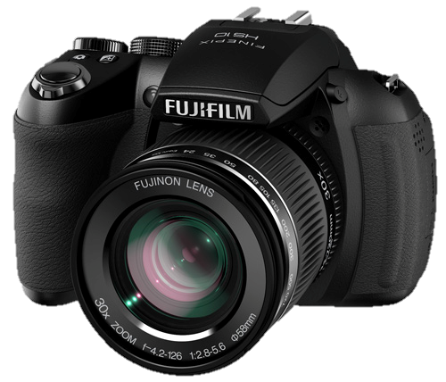
Digital Images

Slide 2
What is a Pixel?
A camera projects an image onto a grid which is called the image sensor. Each section of the grid is called a pixel. Each pixel is a tiny sensor that gathers information from light.
When a picture is taken, the pixels work together to create an image which is sent to the camera’s memory card.
Notes:
Draw a grid on the white board. When a picture is taken all the pixels work together to create an image which is sent to your memory card.

Slide 3
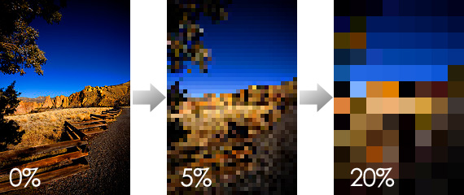
What is a Pixel?
Pixels & Image Quality
Zoom Zoom Zoom
Notes:
When a picture is taken all the pixels work together to create an image which is sent to your memory card. When you zoom in on a picture you are, essentially, zooming in on its pixels! If you make the image large enough, you will be able to view each one of its pixels.

Slide 4
What is a Pixel?
A pixel is a tiny square of colour that helps make up an image
Typically, photographs have several thousand, or million pixels
The more pixels an image has, the higher its resolution (or, quality) …since when there are more pixels, the actual size of each pixel is smaller, therefore they are less blocky and noticeable as individuals.
1 000 000 pixels = 1 megapixel
The more megapixels a camera is able to capture, the higher its quality

Slide 5
What is RESOLUTION?
Resolution is measured by how many pixels high, and how many pixels wide an image or screen is.
For example:
8.5x11 inch printed photo (@ 300 ppi – pixels per inch) = 2550 x 3300 pixels
(therefore you would need a camera that can capture at least 8 megapixels)
Picture of Ms. Hammond on the class website = 150 x 200 pixels (30 000 pixels)
High Definition TV Screen = 1920 x 1080 pixels (~2 megapixels)
For items that are PRINTED, resolution must be very HIGH (min. 150-300 pixels per inch) for an image to look good.
For items that are DISPLAYED ON A SCREEN, resolution can be very LOW (min. 72 pixels per inch) and an image will still look good.
FUN FACT: A low resolution image will not look good on a high resolution screen, but a high resolution image will look good on a low resolution screen.
Notes:
For items that are PRINTED, resolution must be very HIGH (min. 150-300 pixels per inch) for an image to look good.
For items that are DISPLAYED ON THE WEB, resolution can be very LOW (min. 72 pixels per inch) and an image will still look good.

Slide 6
BITMAP IMAGEs
Different coloured pixels arranged into patterns work together to product Bitmap (aka raster) images
Bitmap images can be altered in programs like Photoshop by erasing or changing the colour of the image’s individual pixels
There are 5 major types of bitmap file formats…

Slide 7
Image formats
5 common types of image formats
JPEG – Joint Photographic Experts Group
PNG – Portable Networks Graphic
GIF – Graphics Interchange Format
TIFF – Tagged Image Files Format
RAW – Raw Format

Slide 8
JPEG – Joint Photographic Experts Group
Relatively small in size, with little impact on quality
“Lossy” compression – lose a little bit of information/quality (in the form of pixels) when compressed
Have an inability to permanently store image info. Every time you open, close, or resize your JPEG file it degrades a bit. The more you play with it the more it deteriorates.
Support a large array (16.7 million) of colours
Most commonly used for photographs
Notes:
If your shooting in JPEG you should select the images you really want to keep and convert them to a TIFF.

Slide 9
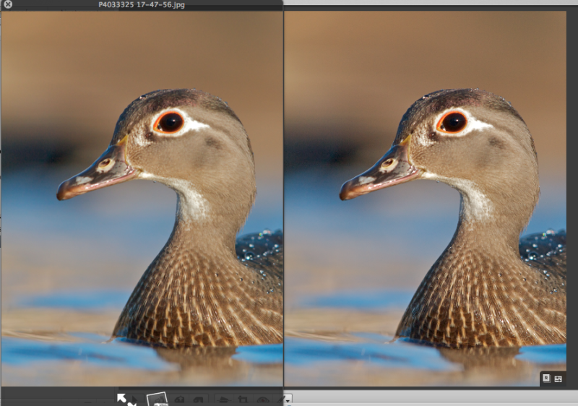
JPEG QUALITY
TIFF QUALITY

Slide 10
PNG – Portable Networks Graphic
Larger than jpegs, but with no impact on quality
“Lossless” compression – don’t lose info (in the form of pixels) when compressed
Have an ability to permanently store image info. No matter how frequently you open, close, and resize the image, the quality will remain the same.
Support transparency (for both foreground and background image)
Support a large array (16.7 million) of colours
Used for both photographs (due to colour range) and web images (due to transparency)
Notes:
If your shooting in JPEG you should select the images you really want to keep and convert them to a TIFF.

Slide 12
GIF – Graphics Interchange Format
Very small in size, with potentially large impact on quality (due to colour palette)
“Lossless” compression – don’t lose info (in the form of pixels) when compressed
Support simple animation
Support a small array (256) of colours
Used for web images (due to small size, limited colours, and support for animation)
Notes:
If your shooting in JPEG you should select the images you really want to keep and convert them to a TIFF.

Slide 13
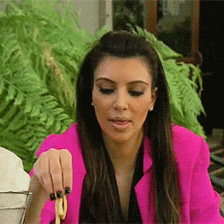

Slide 14
TIFF – Tagged Image Files Format
Largest of all file types (since no compression occurs), but provides the best quality
Will not degrade when opened and closed.
Do not compress any part of the image therefore they are just as crisp as a RAW file… however, they are least commonly used because of their size
You cannot make modifications to a TIFF without a complex photo editor such as Photoshop.
Sometimes used for high-quality and/or large prints
Notes:
You can still make these changes in JPEG but it is very time consuming and must be done in photoshop.

Slide 15
JPEG QUALITY
TIFF QUALITY

Slide 16
RAW – Raw Format
EXTREMELY LARGE
Unprocessed images in their natural state. This means that you can make changes to the exposure, white balance, color temperature, and black and white.
You cannot make modifications to a RAW image without a complex photo editor such as Photoshop or the proprietary software that comes with your camera.
Must be converted to one of the 3 previous file types to become usable (for printing, web design, etc.)
Notes:
You can still make these changes in JPEG but it is very time consuming and must be done in photoshop.

Slide 17
NO EXAMPLE CAN BE shown (due to the fact that RAW PHOTOs cannot be exported and viewed in their raw form)

Slide 18
FILE SIZE vs. QUALITY
All types of image formats are made up of a different number of pixels and/or colours.
The more pixels/colours they have, the larger they are. The size of digital files is measured in kilobytes/megabytes.
When it comes to choosing a file type, you must weigh the pros and cons – there is always a tradeoff!
Larger files = higher quality BUT slower computer processing time and more storage taken up!
Smaller files = lower quality BUT faster computer processing time and less storage taken up!

